Slide 1

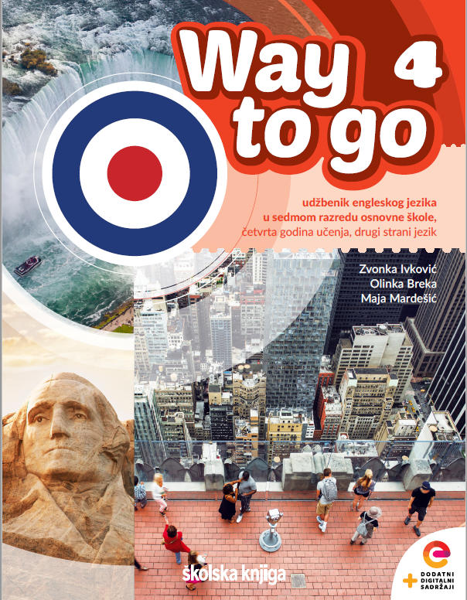
Unit 4: Lesson 14 Fashion and music
U ovoj ćemo lekciji:
uspoređivati present simple i present continuous
govoriti o glazbi, modi i povijesti mode
opisivati osobni stil i stvarati futuristički stil

Slide 2
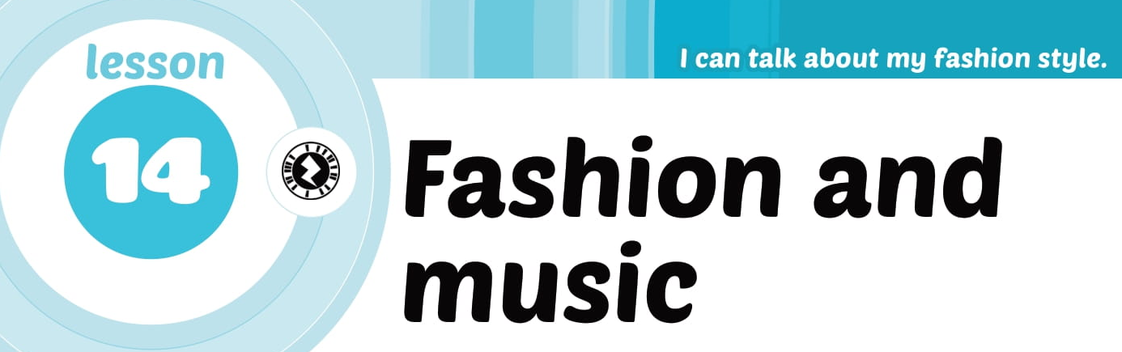

Slide 3
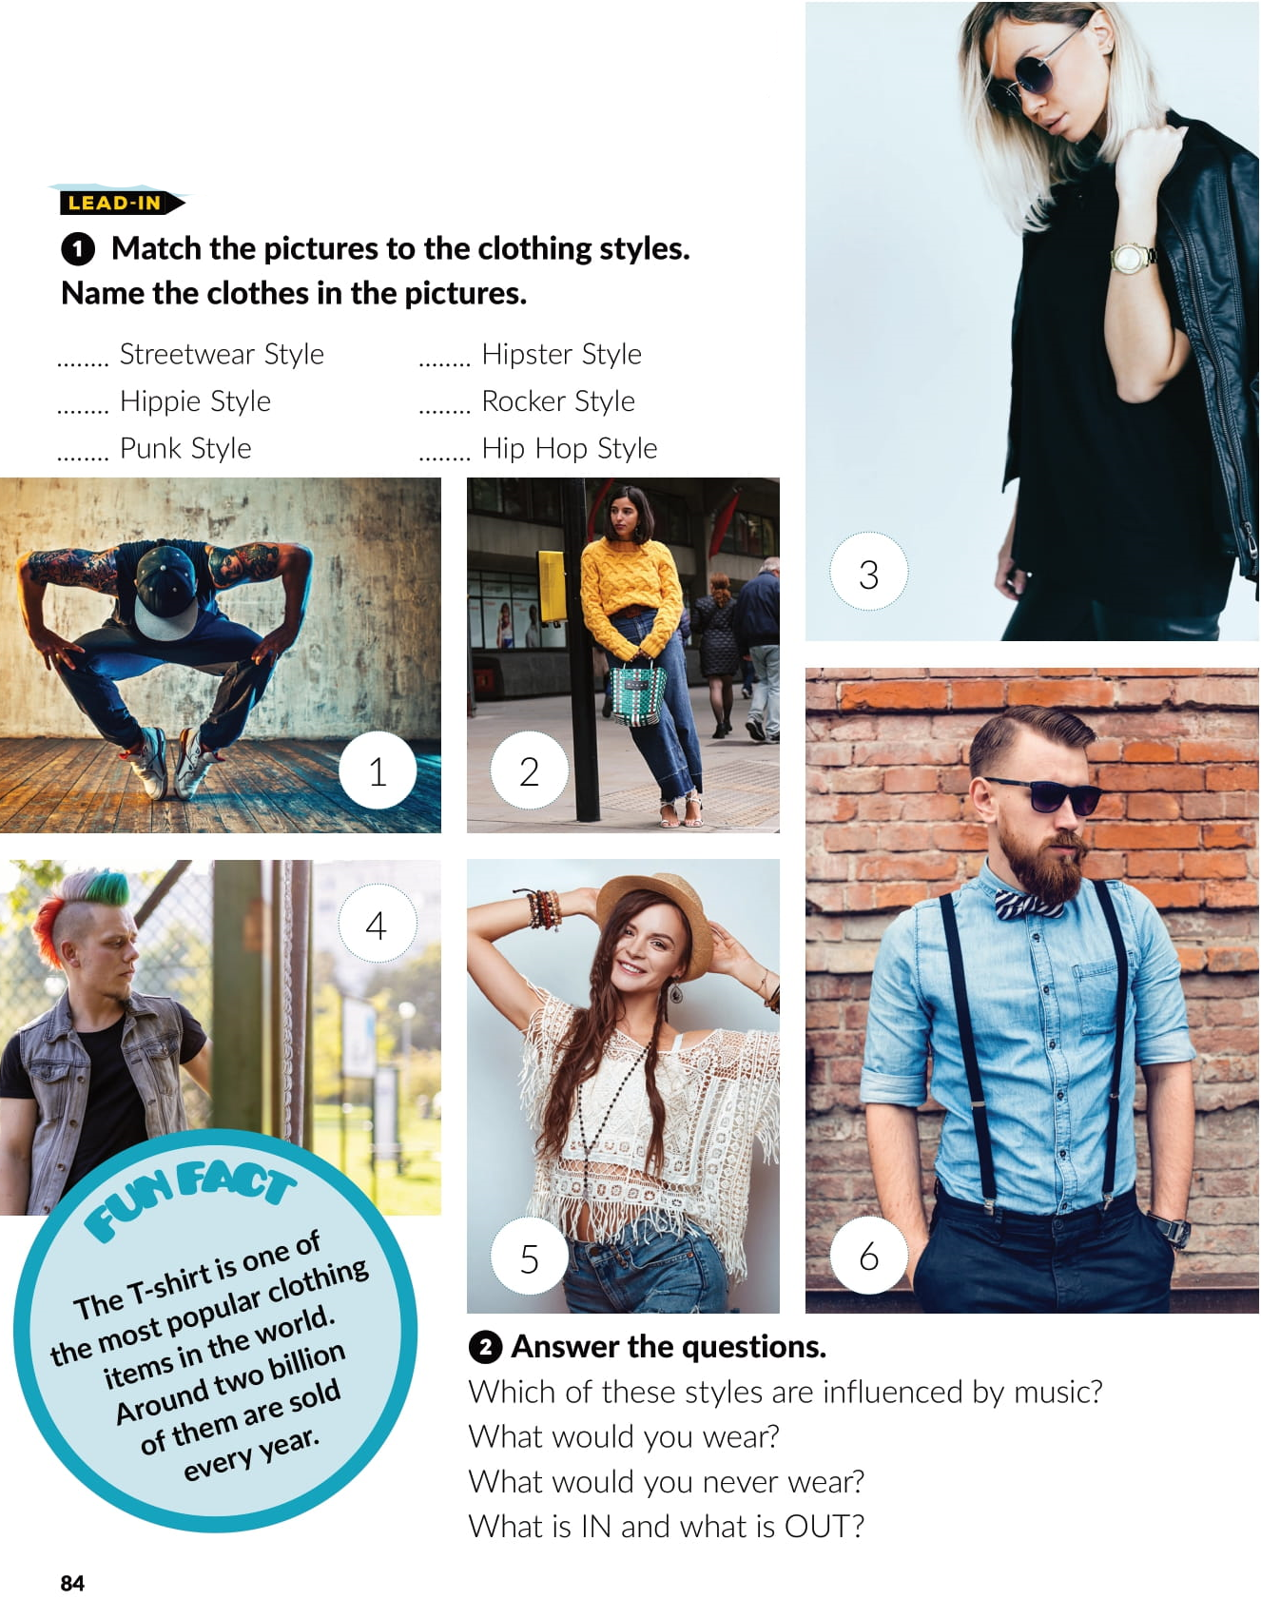
2
6
5
3
4
1

Slide 4
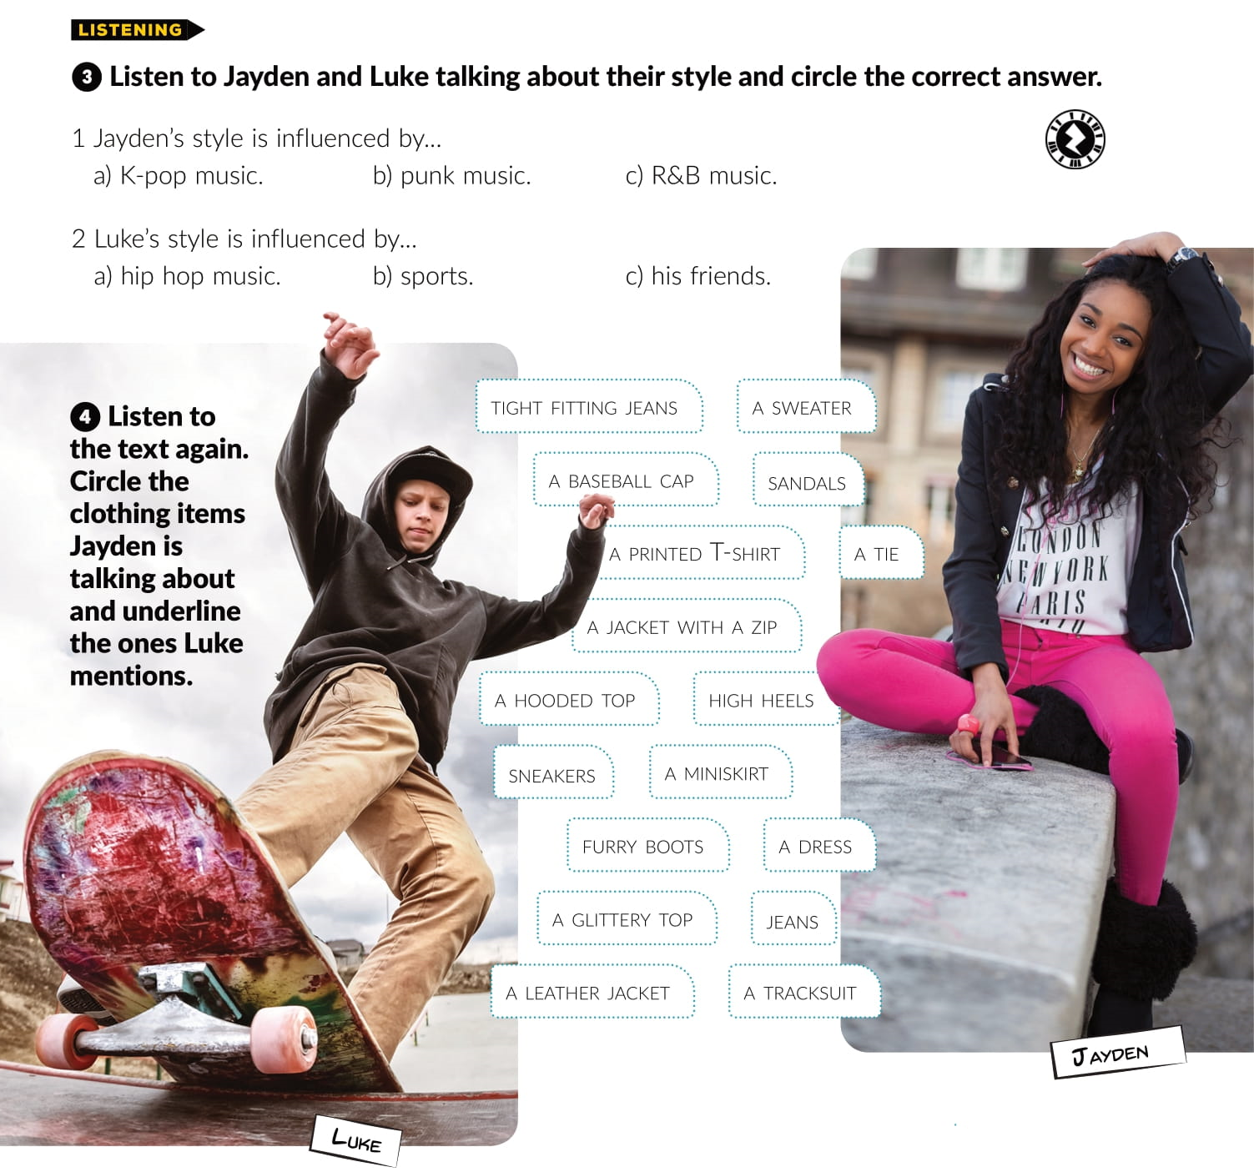


Slide 5
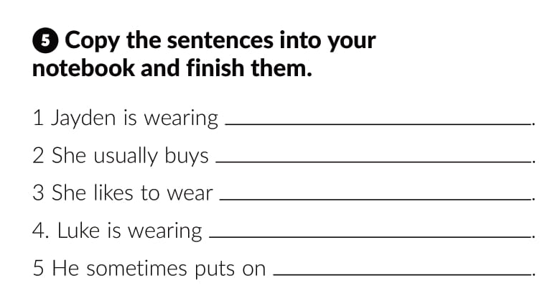
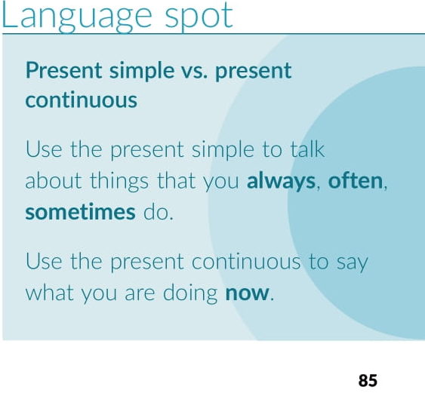
a jacket, a T-shirt and tight fitting jeans
clothes for school, like jeans and T-shirts
mini skirts, glittery tops and sneakers
a hooded top and a baseball cap
leather jacket and jeans

Slide 6
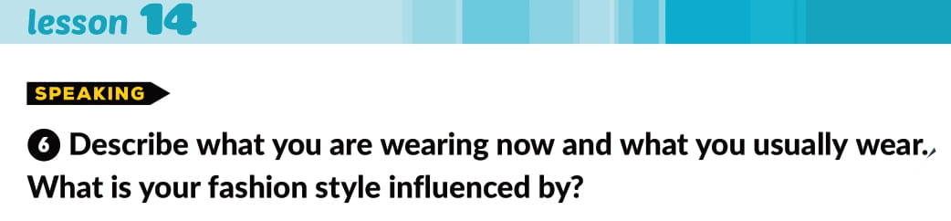
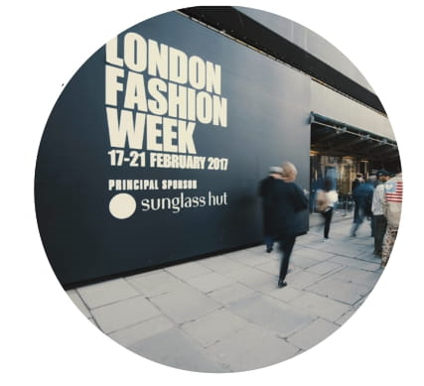

Slide 7
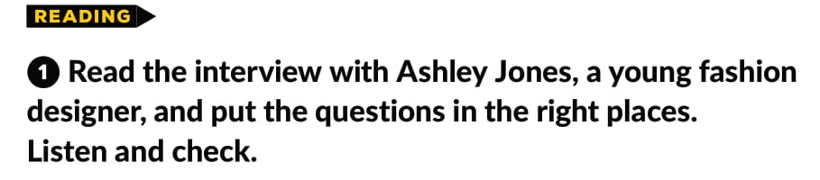
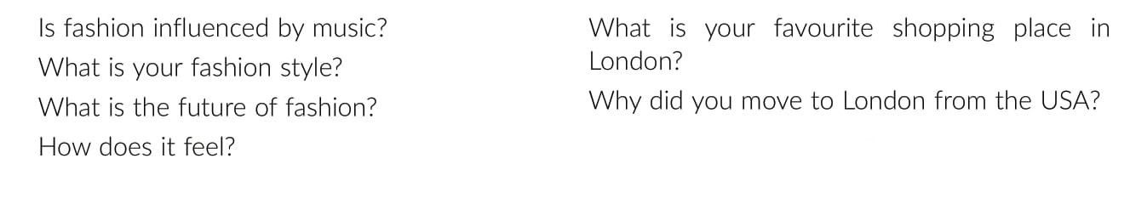
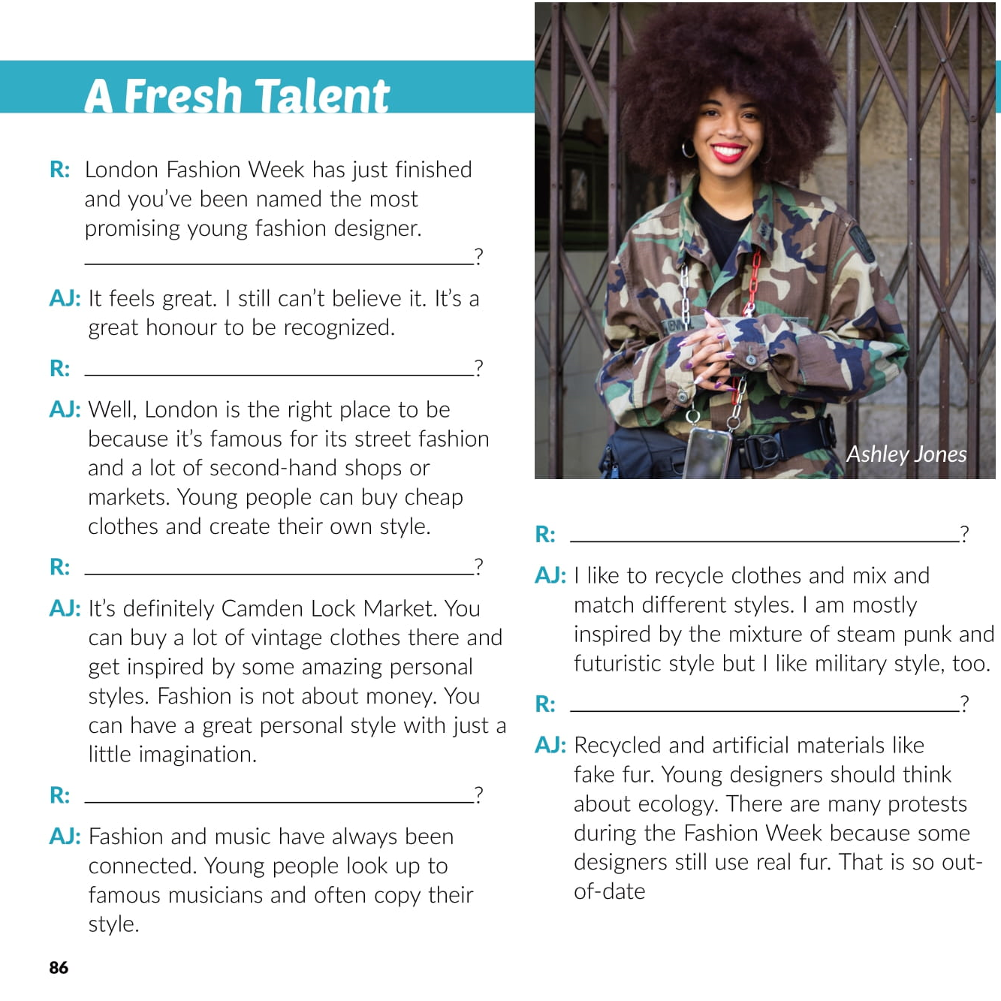
How does it feel?
Why did you move to London from the USA?
What is your fashion style?
What is your favourite shopping place in London?
What is the future of fashion?
Is fashion influenced by music?

Slide 8
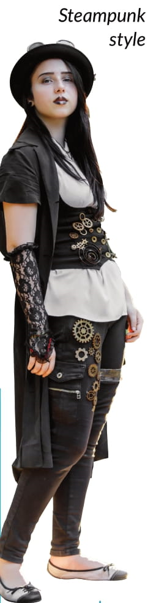

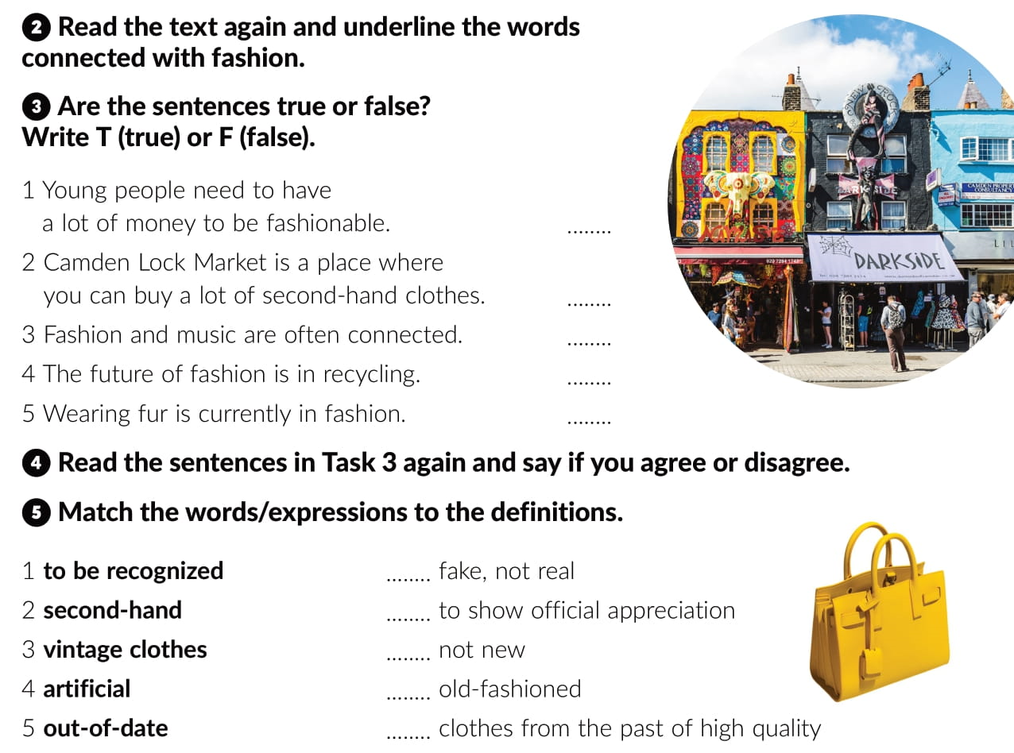
F
T
T
T
F
4
1
2
5
3

Slide 9
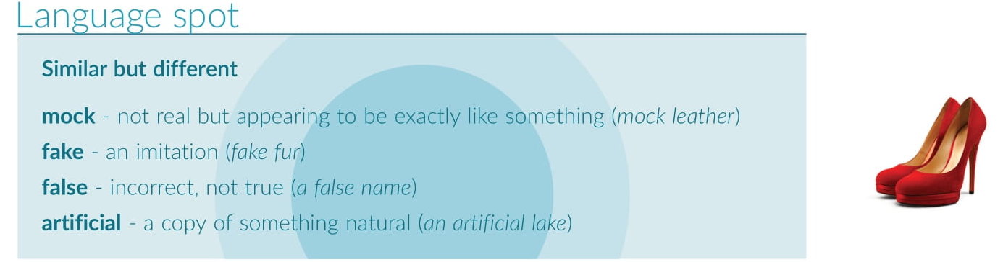

Slide 10
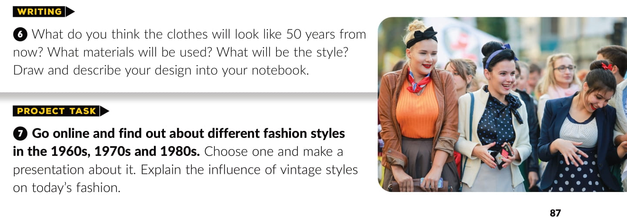

Slide 11
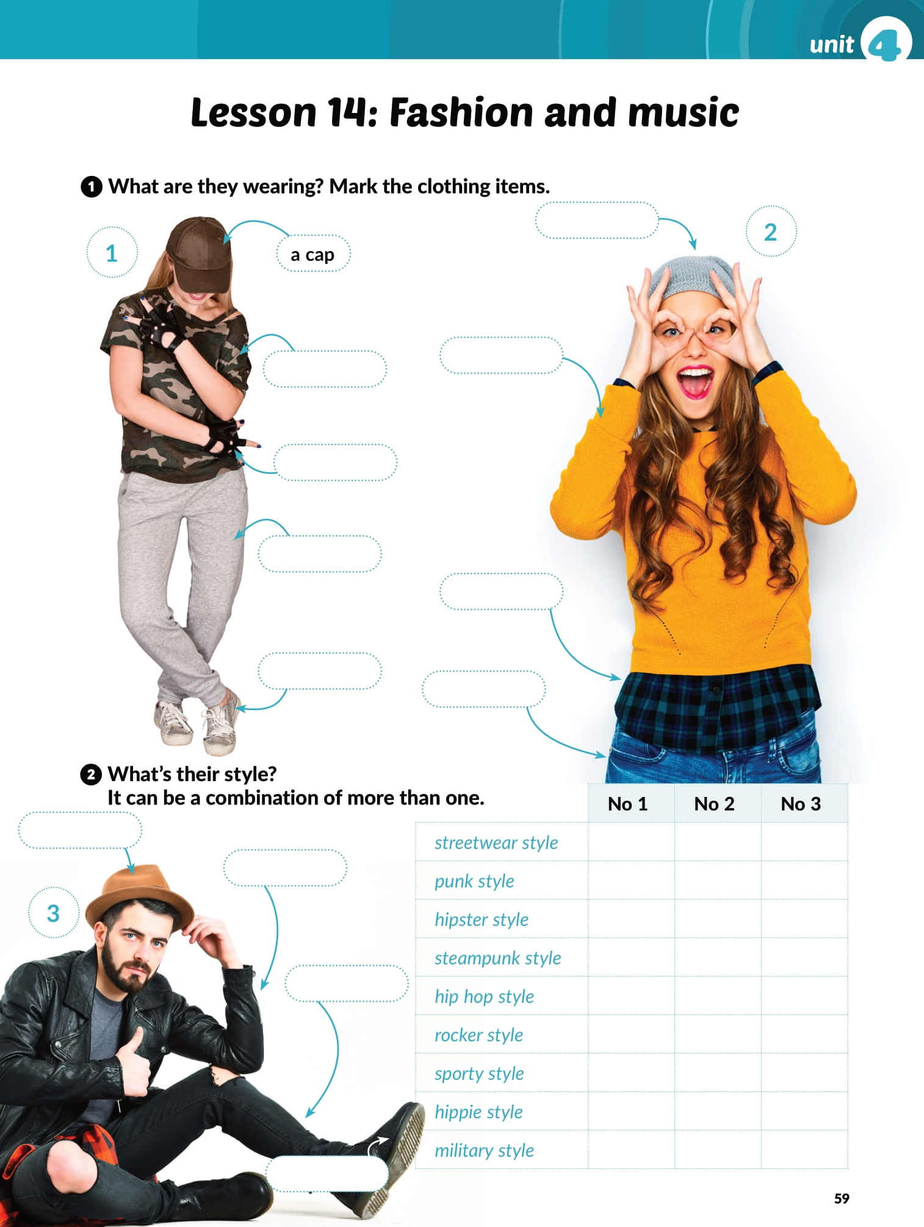

cap
a T-shirt
sweater
gloves
tracksuit bottoms
checked shirt
sneakers
jeans
hat
leather jacket
ripped jeans
boots

Slide 12
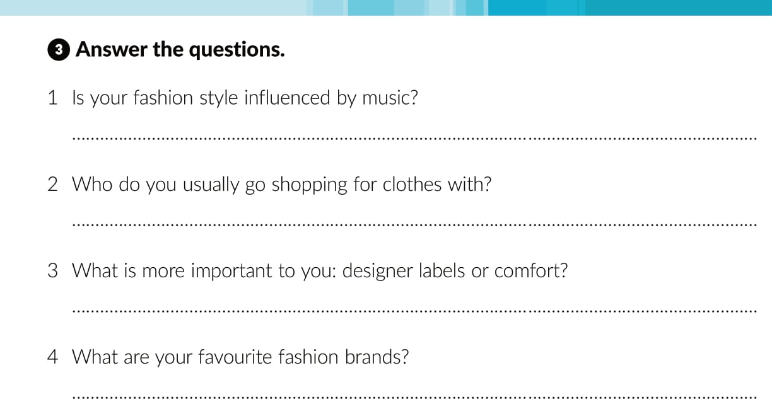

Slide 13
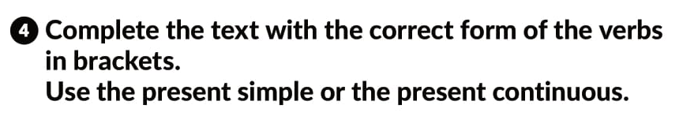
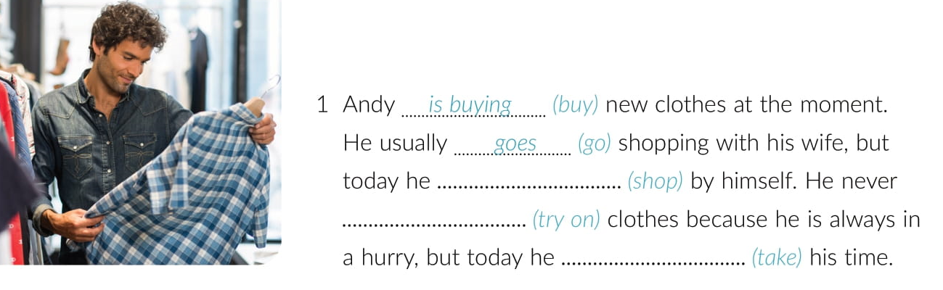
is shopping
tries on
is taking

Slide 14
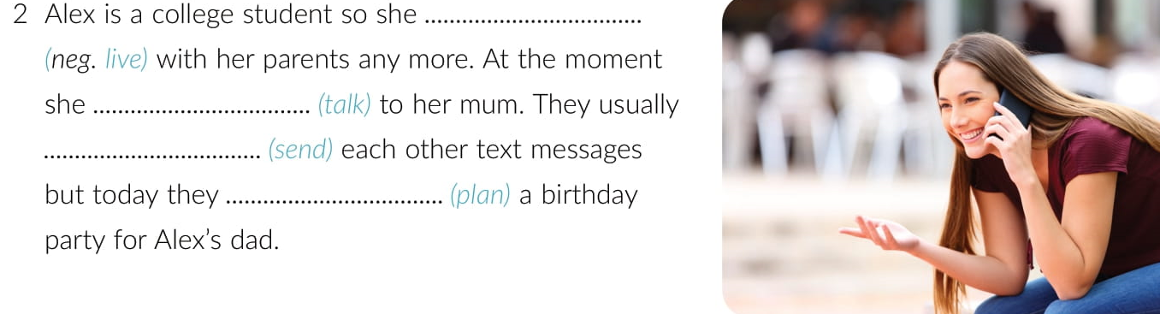
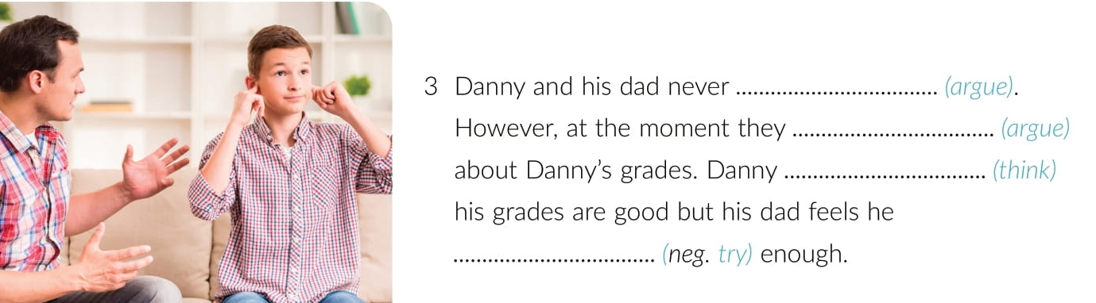
does not live
is talking
send
are planning
argue
are arguing
thinks
isn’t trying

Slide 15
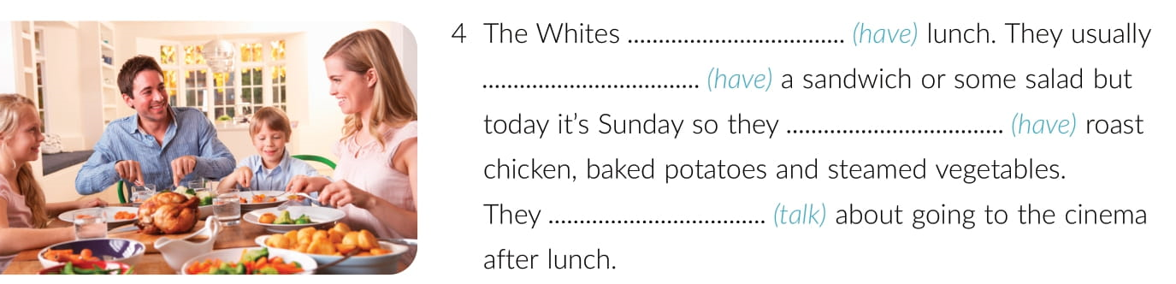
are having
have
are having
are talking

Slide 16
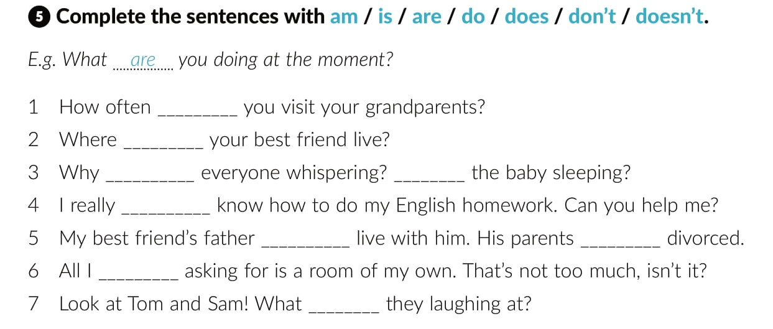
do
does
is
Is
don’t
doesn’t
are
am
are

Slide 17
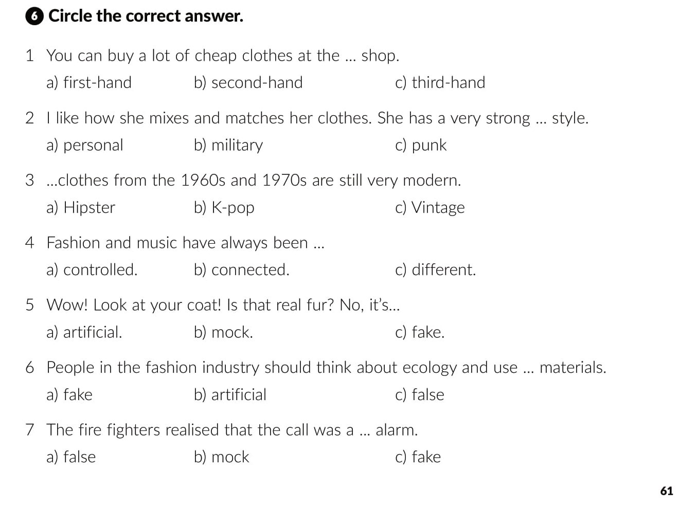

Slide 18
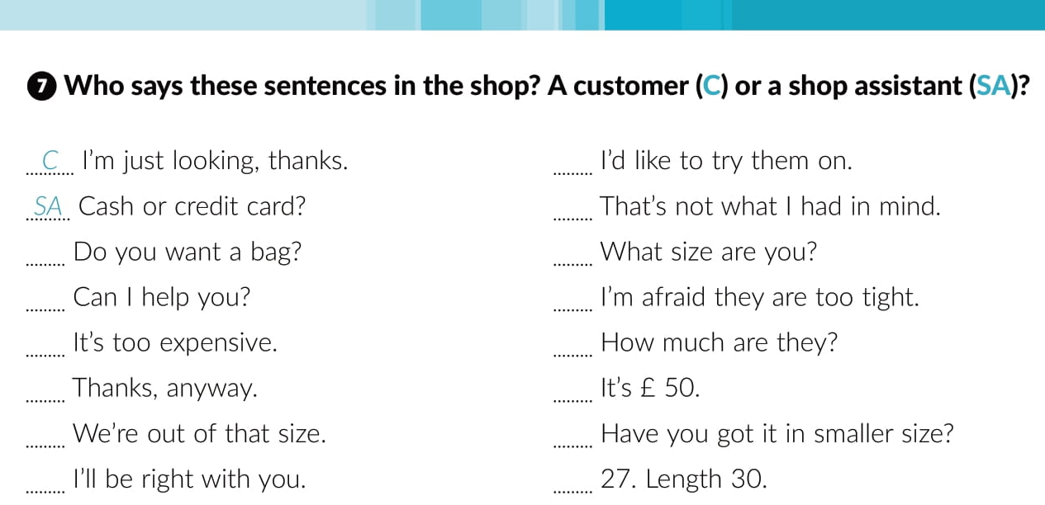
C
C
SA
SA
SA
C
C
C
C
SA
SA
C
SA
C

Slide 19
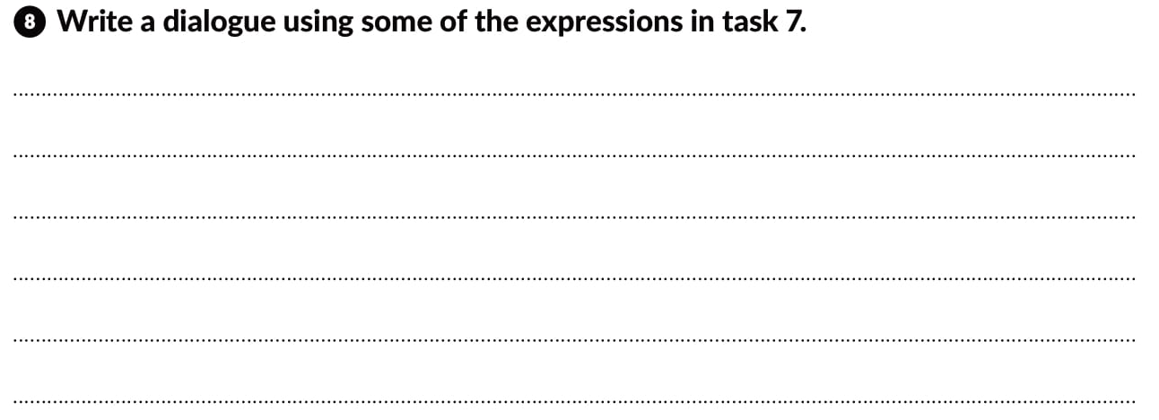

Slide 20

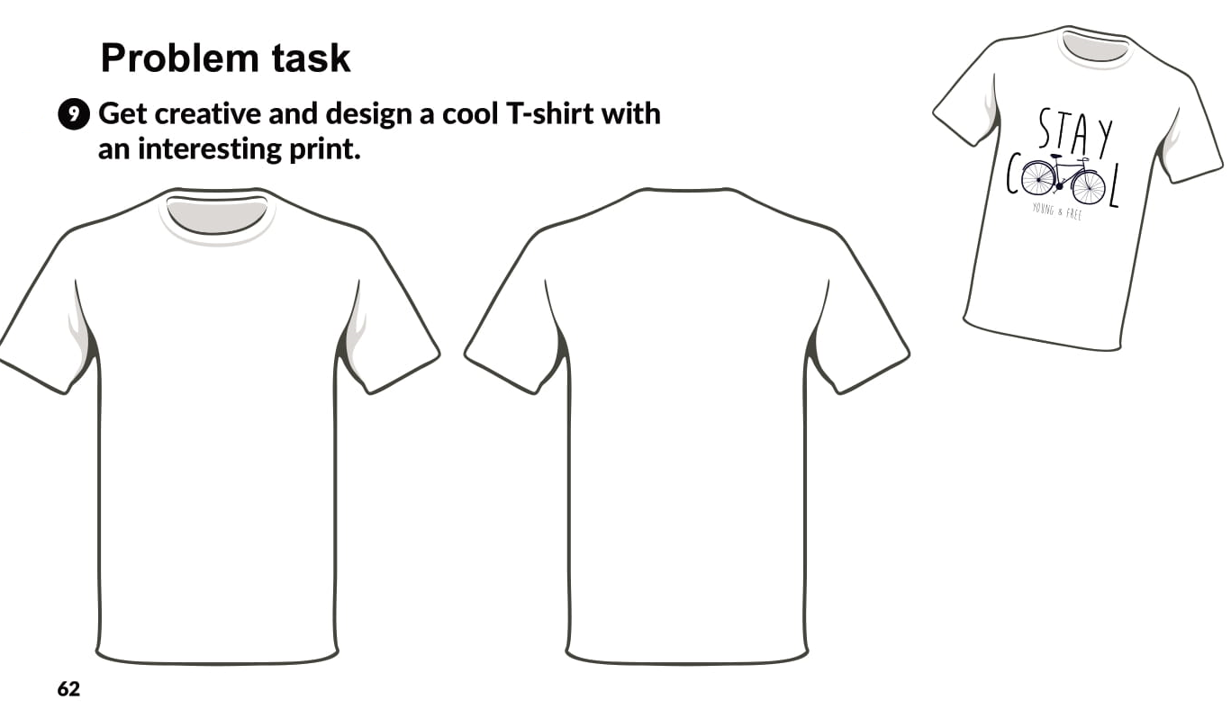

Slide 21
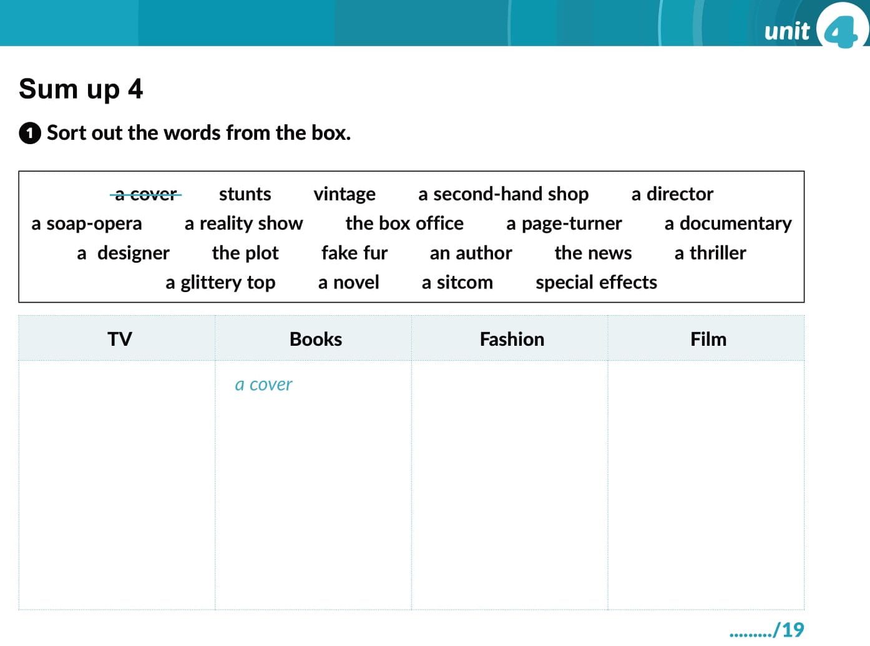
a soap-opera
vintage
stunts
a reality show
a page-turner
a second-hand shop
a director
a documentary
the plot
a designer
the box office
the news
an author
fake fur
a thriller
a sitcom
a novel
a glittery top
special effects

Slide 22
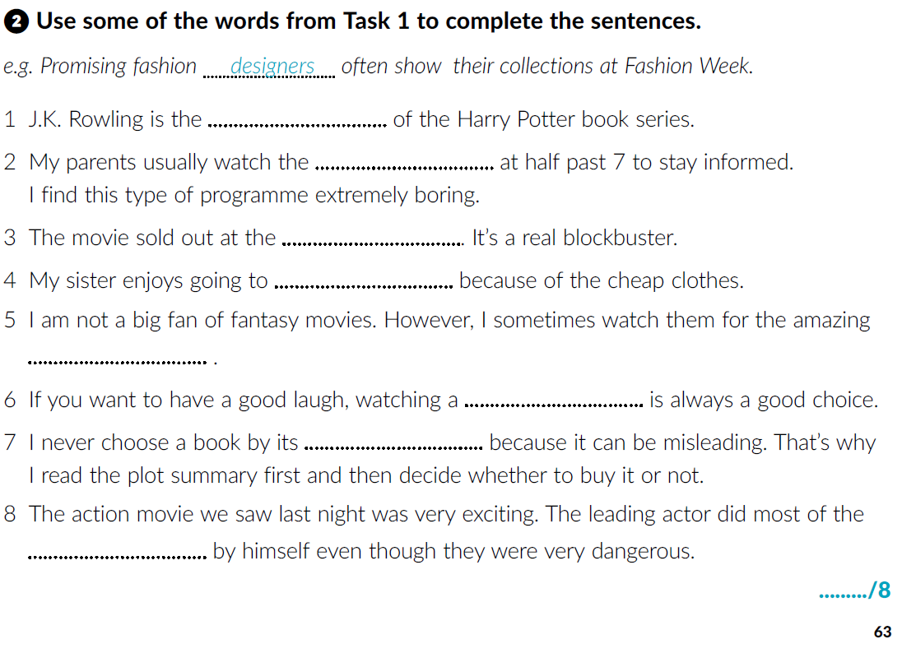
author
news
box-office
second-hand shops
special effects
sitcom
cover
stunts

Slide 23
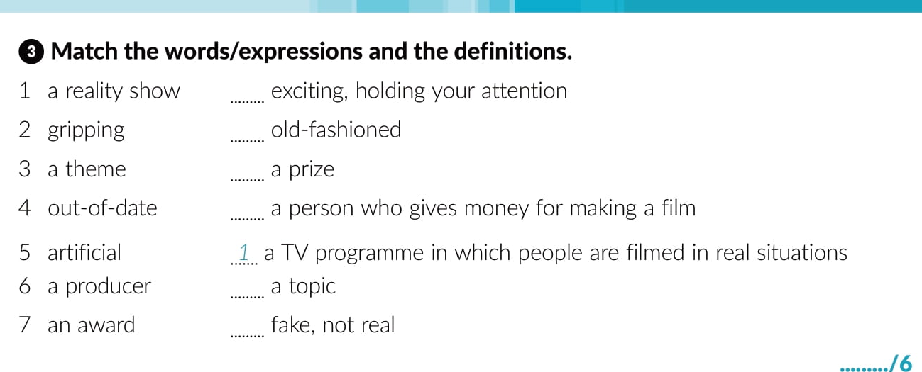
2
4
7
6
3
5

Slide 24
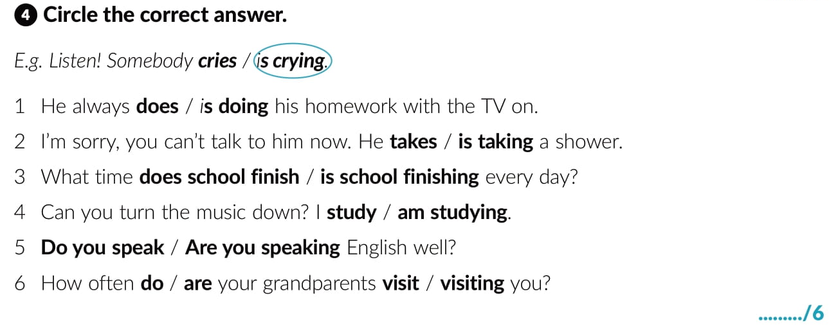

Slide 25
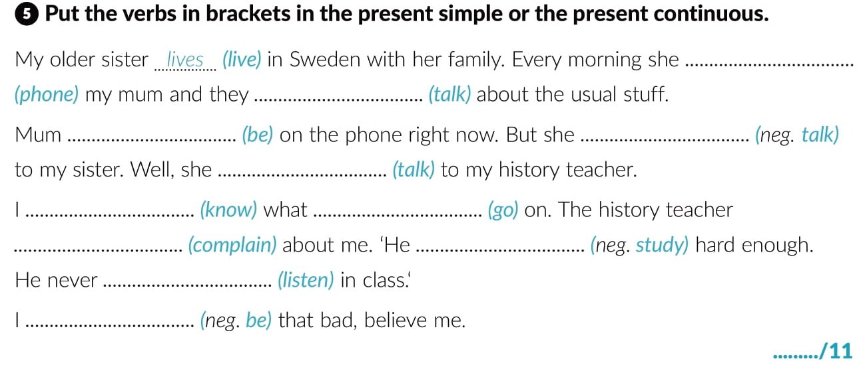
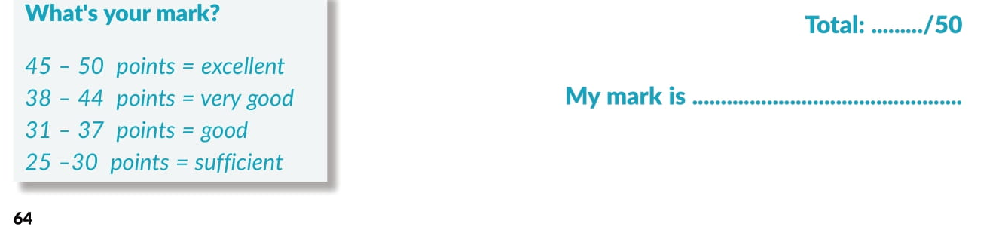
phones
talk
is
isn’t talking
is talking
know
is going
is complaining
doesn’t study
listens
am not

Slide 26
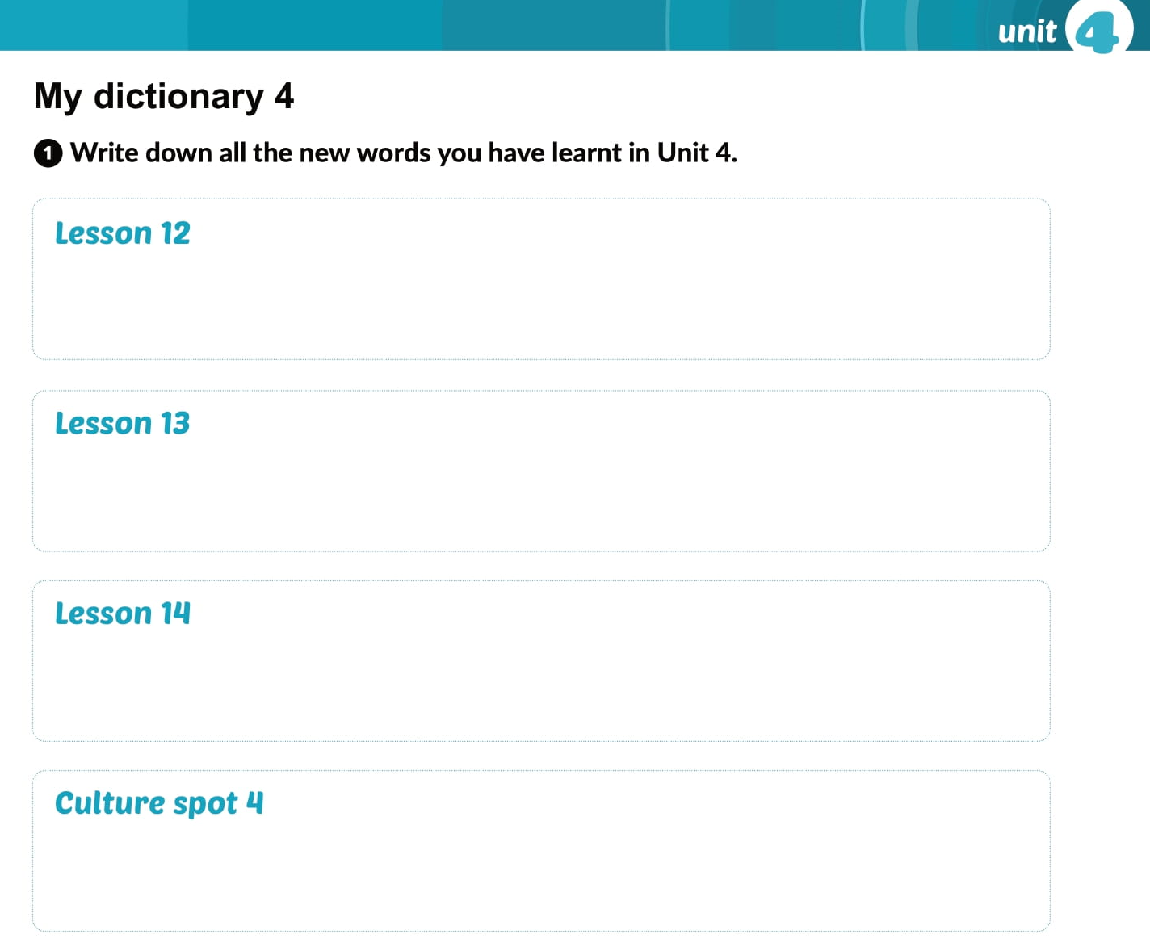

Slide 27

PLAY AND LEARN!
Lesson 14 Fashion and music | Way to go 4 (e-sfera.hr)

